Slide 1


Temperature Prediction
March 31st, 2023

Slide 2
Contents
Overview
Understanding the data
Data Exploration
Training and Testing
What is next?
Q&A

Slide 3
Overview
Importance of Accurate Weather Prediction
Economic Benefits
Machine Learning Analysis for Weather Forecasting
Social Benefits of Accurate Weather prediction
Economic benefits
Accurate Weather Prediction
ML for weather prediction
Social Benefits

Slide 4
Understanding the data
01
04
Temperature
Pressure
02
05
Solar Radiation
Wind Direction
03
06
Humidity
Wind Speed

Slide 5
Data Exploration
Pearson correlation Values
Temperature Vs. Radiation 0.56
Temperature Vs. Wind Speed 0.45
Temperature Vs. Pressure -0.53
Temperature Vs. Humidity -0.75

Slide 6
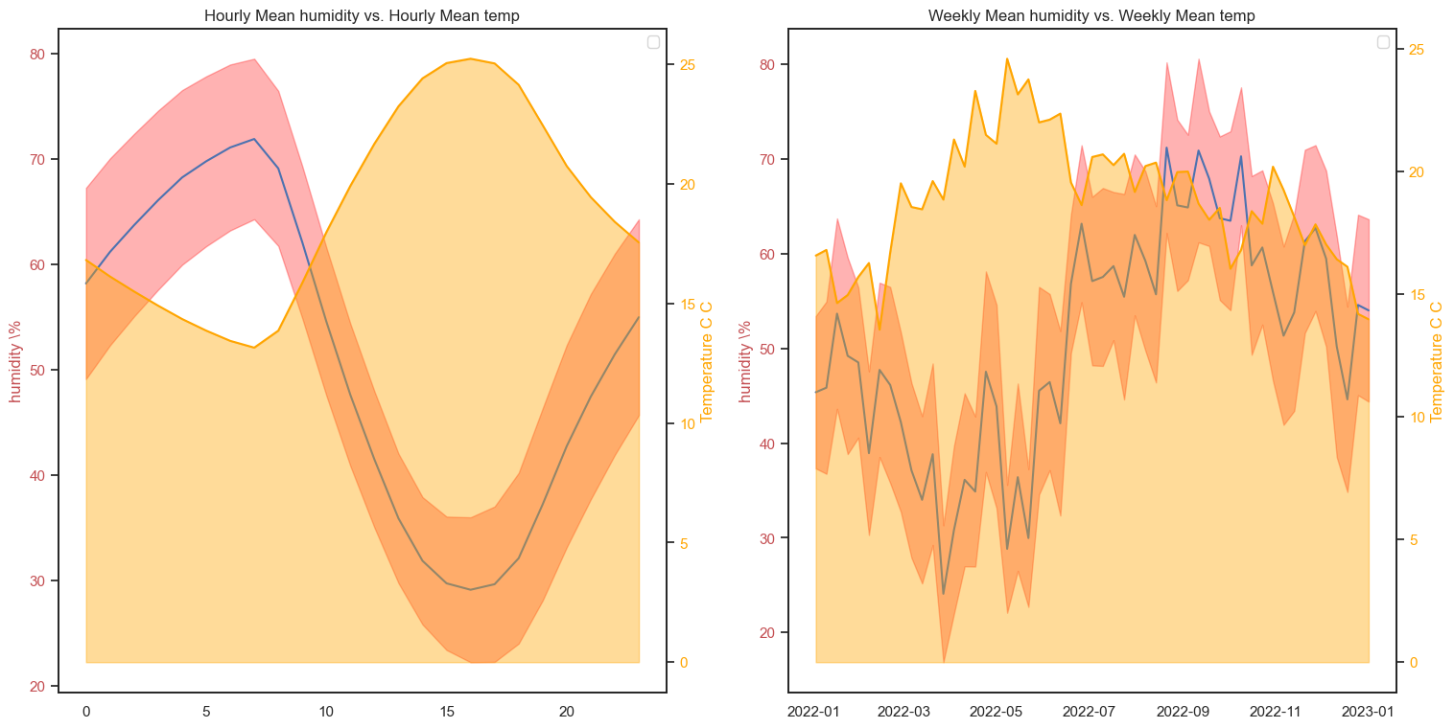

Slide 7
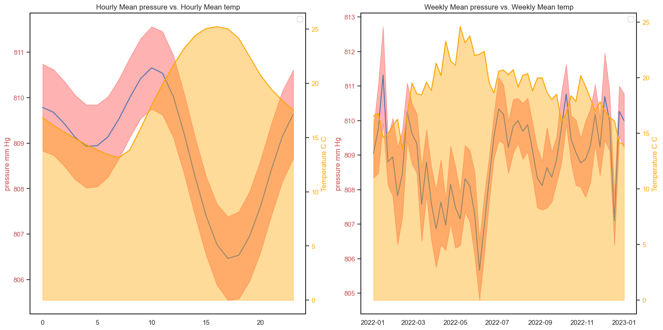

Slide 8
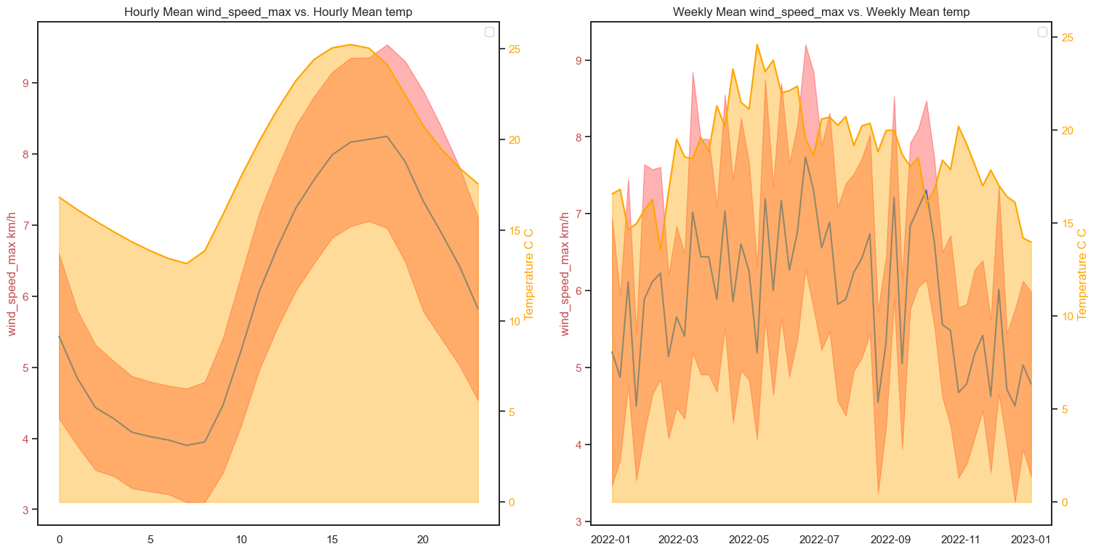

Slide 9
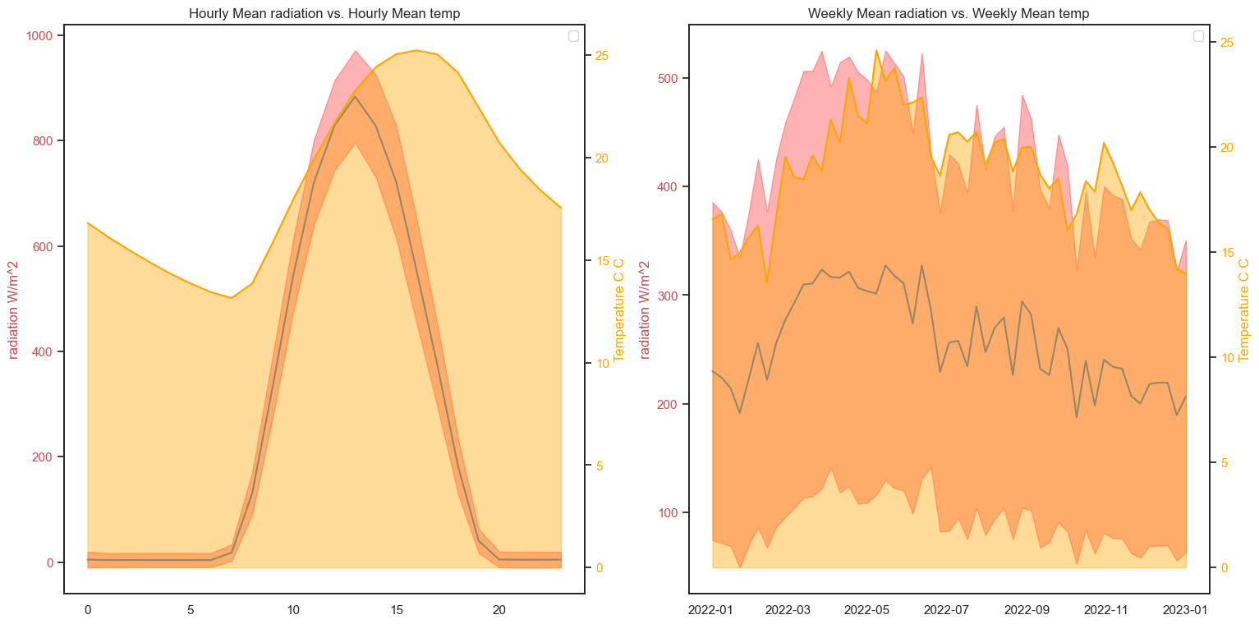

Slide 10

Training & Testing
Linear Regression
Random Forest Regression
Supper Vector Regression (SVR)

Slide 11
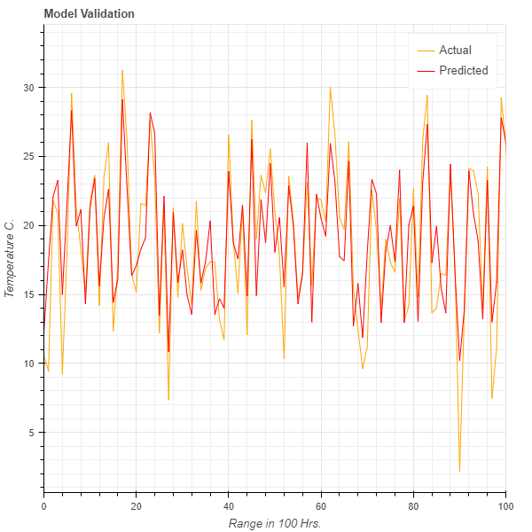
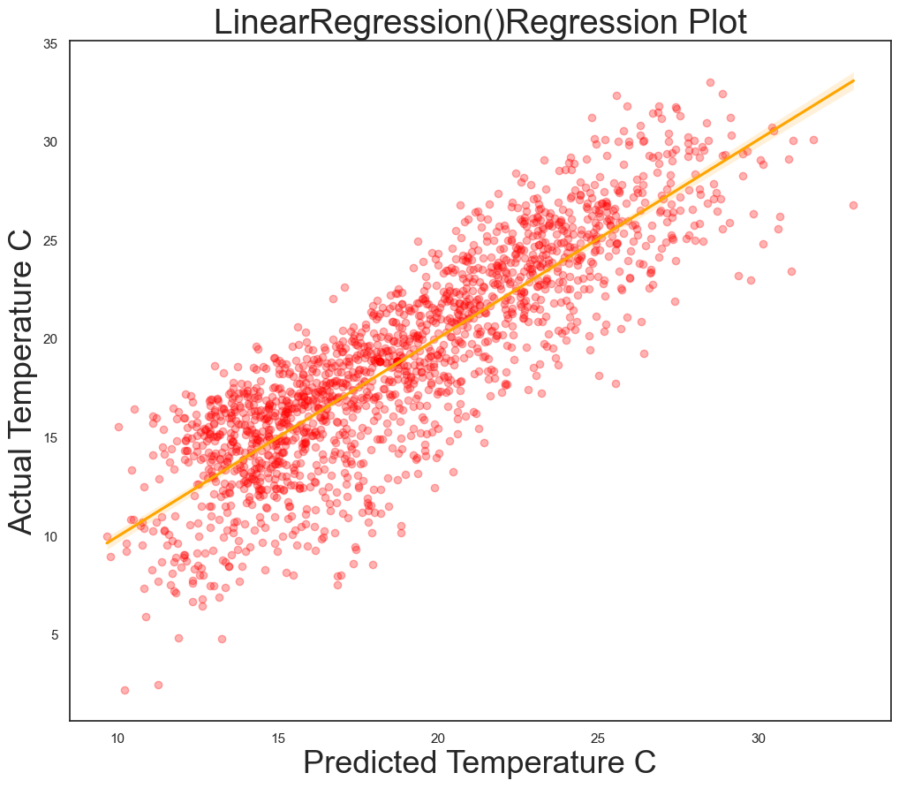
Linear Regression

Slide 12
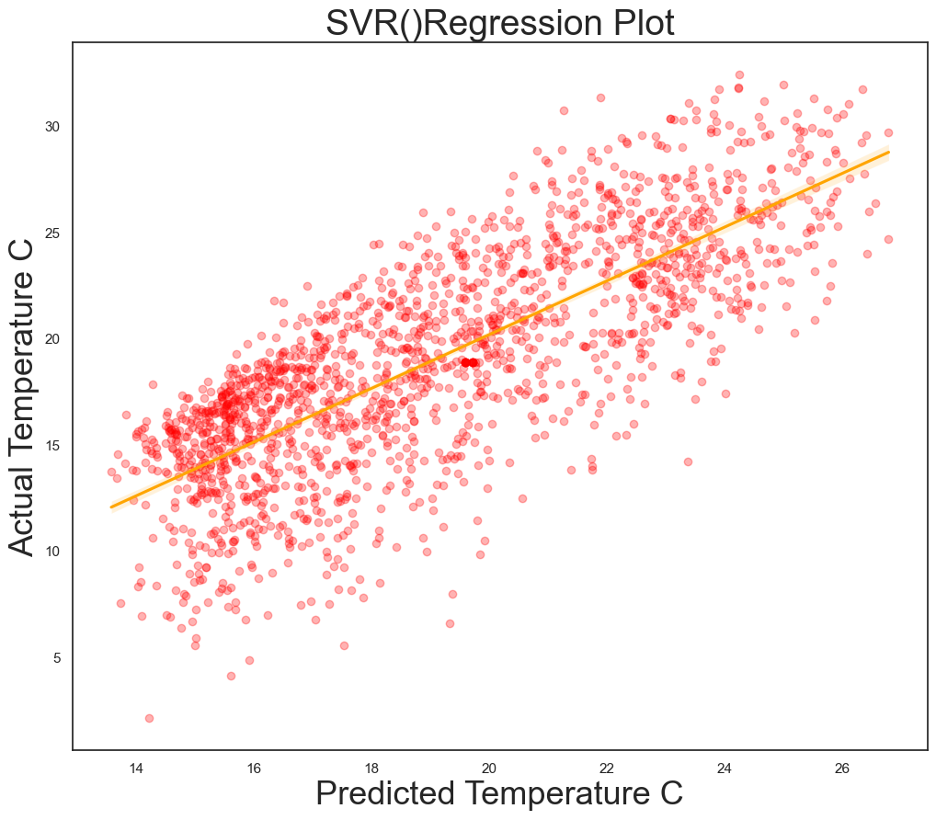
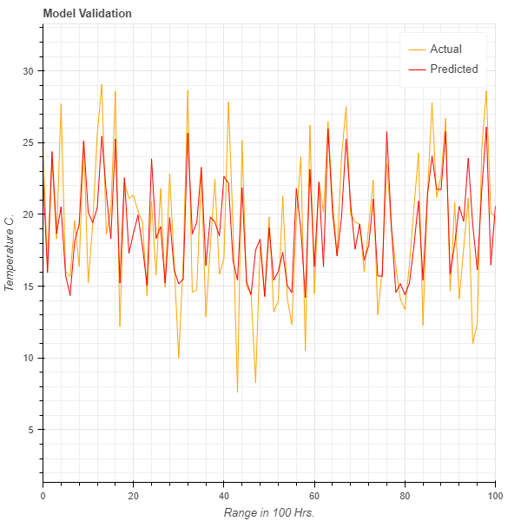
Super Vector Regression

Slide 13
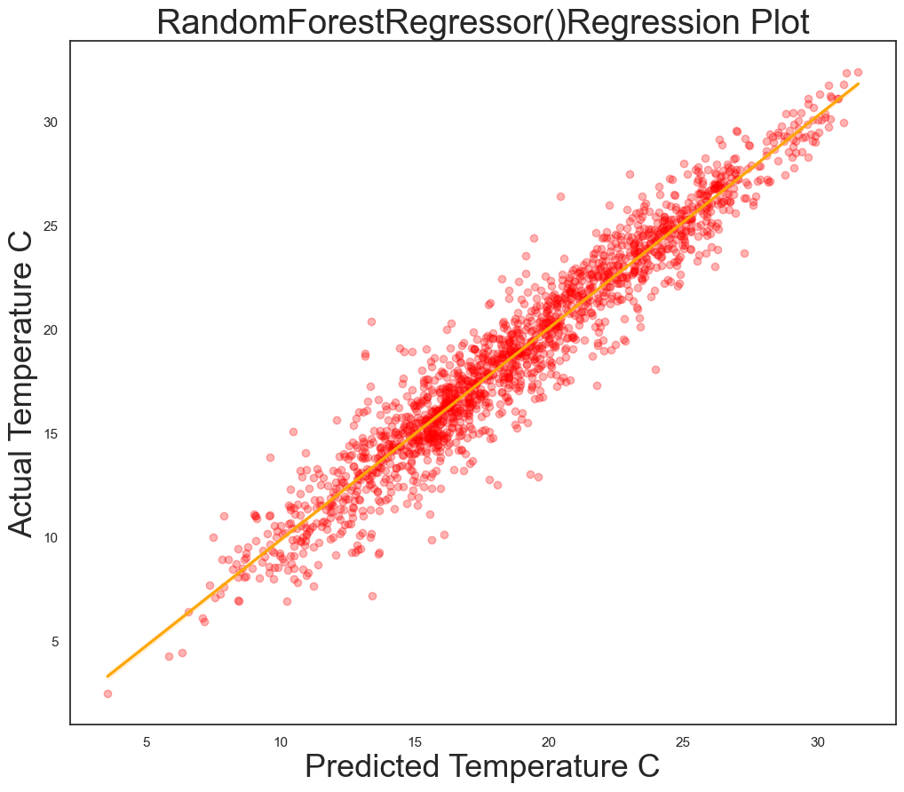
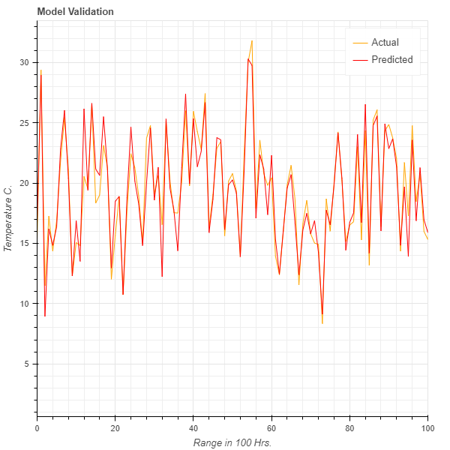
Random Forest Regression

Slide 14

What is next?

Slide 15
Thanks for you attention!

